Slide 1



BTPN Syariah
Data Engineer Virtual Internship Program – February 2023
Enhancing Business Performance through
Segmentation Analysis Strategies
By Adrian Maulana Muhammad
https://github.com/adrn-mm/final-project-VIX-DE-BTPN

Slide 2

Table of Contents
Business Understanding
1.
Data Understanding
2.
3.
Extract, Transform, and Load Process
4.
Exploratory Data Analysis
Analytics Dashboard
5.
Machine Learning: Classification
6.
Summaries
7.
Recommendations
8.
References
9.

Slide 3

Business Understanding

Slide 4

Background
The bank intends to enhance its business performance by using historical customer data to develop better marketing strategies, boost customer retention, and mitigate credit risk. To accomplish these objectives, the bank must comprehend its customers' attributes and pinpoint opportunities for increasing sales of additional products to existing customers while concurrently reducing churn rate and credit risk.

Slide 5
Problem Description
Based on the previously mentioned background, I have divided the problems in this project as follows:
The bank needs to utilize its historical customer data to segment customers into more targeted groups, helping it develop more effective marketing and selling strategies.
The bank needs to identify high credit-risk customers, enabling them to take appropriate preventive actions and reduce their credit risk.
The bank needs to analyze churn and identify the factors causing customers to discontinue using their services, thus helping them develop more effective retention strategies to retain customers.

Slide 6
Business Objectives
Based on the background explanation and problem description, I have formulated several business objectives for this project:
Conduct segmentation analysis by dividing customers into different groups based on their characteristics, such as customer status, age, gender, education, marital status, number of dependents, income, and type of credit card used. This will help the bank understand its customers better and develop more effective marketing strategies.
Perform credit risk analysis by examining data on credit limits, revolving balances, and credit utilization ratios to identify high-risk customers. This will help the bank take appropriate preventive action to reduce its credit risk.
Conduct churn analysis by looking at transactional activity, the total number of products used, and the total number of contacts made by the bank to identify the factors that cause customers to stop or continue using the bank's services. This will help the bank develop more effective retention strategies to keep customers loyal to their services.

Slide 7
Data Understanding

Slide 8
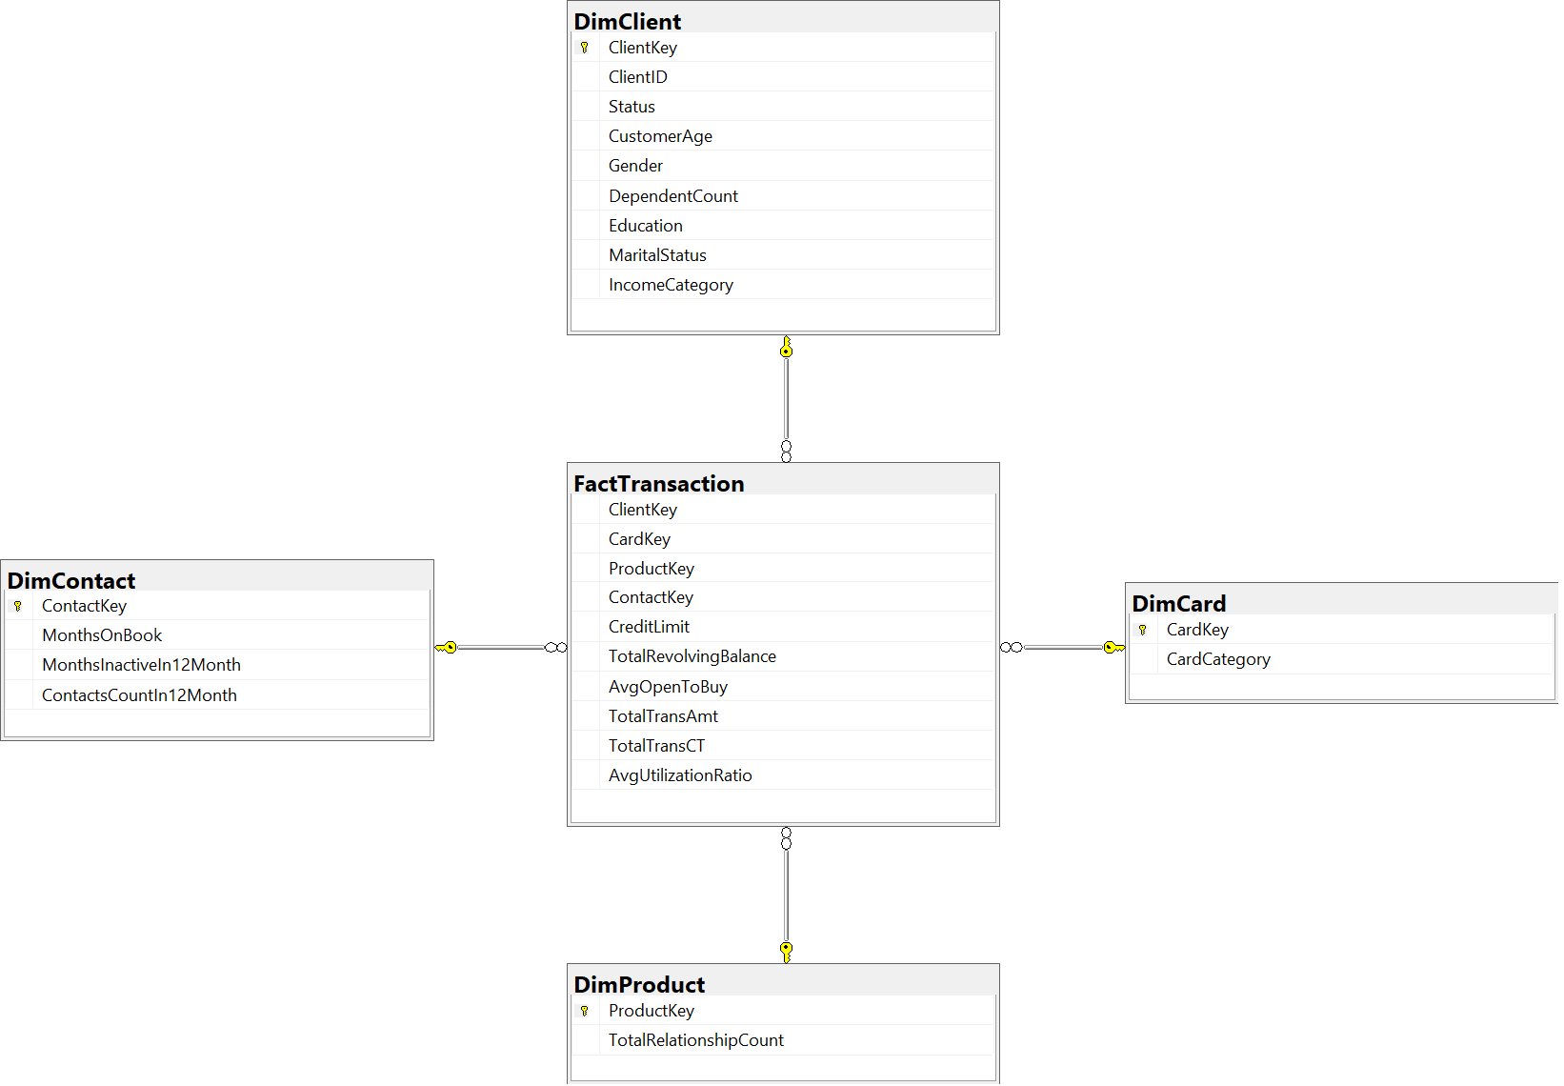
Data Model

Slide 9
Data Summaries
Table | Summary
FactTransaction | The transaction data and related information, such as the client, card, product, and contact involved in each transaction.
DimClient | Information about the clients, such as their key, name, age, gender, education level, marital status, income category, and dependent count.
DimCard | Information about the credit cards, such as their key, category, and type.
DimContact | Information about the contact channels, such as their key, inactive months in 12 months, contact count in 12 months, and months on book.
DimProduct | information about the bank products, such as their key, type, and total relationship count.

Slide 10
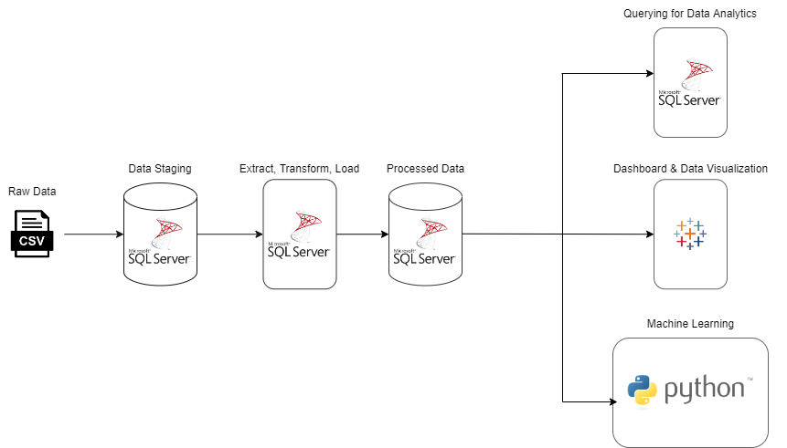
Data Pipeline

Slide 11
Extract, Transform, and Load Process

Slide 12
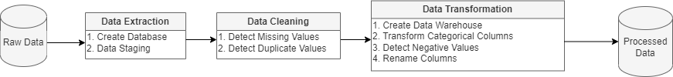
ETL Process Pipeline

Slide 13
Data Extraction Queries
Data Staging
-- use the database
USE CustomerHistoryData;
-- create a new table
CREATE TABLE dbo.DataStaging(
CLIENTNUM int,
idstatus int,
Customer_Age int,
Gender varchar(255),
Dependent_count int,
Educationid int,
Maritalid int,
Income_Category varchar(255),
Card_Category int,
Months_on_book int,
Total_Relationship_Count int,
Months_Inactive_12_mon int,
Contacts_Count_12_mon int,
Credit_Limit float,
Total_Revolving_Bal int,
Avg_Open_To_Buy float,
Total_Trans_Amt int,
Total_Trans_Ct int,
Avg_Utilization float
);
-- import the file
BULK
INSERT dbo.DataStaging
FROM ‘path\customer_data_history.csv' WITH(FORMAT = 'CSV', FIRSTROW = 2);
Create Database
-- create a new database for this project
CREATE DATABASE CustomerHistoryData;

Slide 14
Data Cleaning Queries
Detect Missing Values
-- use the database
USE CustomerHistoryData;
-- Checking for missing values in the primary key in the data staging table
SELECT *
FROM dbo.DataStaging
WHERE CLIENTNUM IS NULL;
Detect Duplicate Values
-- use the database
USE CustomerHistoryData;
-- Checking duplicate values in the primary key in the data staging table
SELECT CLIENTNUM,
COUNT(CLIENTNUM)
FROM dbo.DataStaging
GROUP BY CLIENTNUM
HAVING COUNT(CLIENTNUM) > 1

Slide 15
Data Transformation Queries - 1
Detect Negative Values
-- use the database
USE CustomerHistoryData -- detect the negative values
SELECT COUNT(*) AS TotalNegativeRows
FROM dbo.DataWarehouse
WHERE Months_on_book < 0
OR Total_Relationship_Count < 0
OR Months_Inactive_12_mon < 0
OR Contacts_Count_12_mon < 0
OR Credit_Limit < 0
OR Total_Revolving_Bal < 0
OR Avg_Open_To_Buy < 0
OR Total_Trans_Amt < 0
OR Total_Trans_Ct < 0
OR Avg_Utilization < 0;
Create Data Warehouse
-- use the database
USE CustomerHistoryData;
-- create a new table (data warehouse)
SELECT * INTO dbo.DataWarehouse
FROM dbo.DataStaging;

Slide 16
Data Transformation Queries - 2
Transform Categorical Columns (2)
-- use the database
USE CustomerHistoryData
-- transform categorical data
UPDATE dbo.DataWarehouse
SET Idstatus = CASE
WHEN Idstatus = 1 THEN 'Existing Customer'
WHEN Idstatus = 2 THEN 'Attrited Customer'
ELSE 'Unknown'
END,
Customer_Age = CASE
WHEN Customer_Age < 30 THEN '20s'
WHEN Customer_Age >= 30
AND Customer_Age < 40 THEN '30s'
WHEN Customer_Age >= 40
AND Customer_Age < 50 THEN '40s'
WHEN Customer_Age >= 50
AND Customer_Age < 60 THEN '50s'
WHEN Customer_Age >= 60
AND Customer_Age < 70 THEN '60s'
WHEN Customer_Age >= 70 THEN '70s+'
ELSE 'Unknown'
END,
Educationid = CASE
WHEN Educationid = 1 THEN 'High School'
WHEN Educationid = 2 THEN 'Graduate'
WHEN Educationid = 3 THEN 'Uneducated'
WHEN Educationid = 4 THEN 'Unknown'
WHEN Educationid = 5 THEN 'College'
WHEN Educationid = 6 THEN 'Post-Graduate'
WHEN Educationid = 7 THEN 'Doctorate'
ELSE 'Unknown'
END;
Transform Categorical Columns (1)
-- use the database
USE CustomerHistoryData;
-- change table column's data type before transforming
ALTER TABLE dbo.DataWarehouse
ALTER COLUMN Idstatus VARCHAR(255);
ALTER TABLE dbo.DataWarehouse
ALTER COLUMN Customer_Age VARCHAR(255);
ALTER TABLE dbo.DataWarehouse
ALTER COLUMN Educationid VARCHAR(255);
ALTER TABLE dbo.DataWarehouse
ALTER COLUMN Maritalid VARCHAR(255);
ALTER TABLE dbo.DataWarehouse
ALTER COLUMN Card_Category VARCHAR(255);
ALTER TABLE dbo.DataWarehouse
ALTER COLUMN Dependent_count VARCHAR(255);

Slide 17
Data Transformation Queries - 3
Rename Columns (1)
-- Use the database you want to work with
USE CustomerHistoryData;
-- Rename the columns
EXEC sp_rename 'dbo.DataWarehouse.CLIENTNUM',
'ClientID',
'COLUMN';
EXEC sp_rename 'dbo.DataWarehouse.idstatus',
'Status',
'COLUMN';
EXEC sp_rename 'dbo.DataWarehouse.Customer_Age',
'CustomerAge',
'COLUMN';
EXEC sp_rename 'dbo.DataWarehouse.Dependent_count',
'DependentCount',
'COLUMN';
EXEC sp_rename 'dbo.DataWarehouse.Educationid',
'Education',
'COLUMN';
EXEC sp_rename 'dbo.DataWarehouse.Maritalid',
'MaritalStatus',
'COLUMN';
EXEC sp_rename 'dbo.DataWarehouse.Income_Category',
'IncomeCategory',
'COLUMN';
EXEC sp_rename 'dbo.DataWarehouse.Card_Category',
'CardCategory',
'COLUMN';
EXEC sp_rename 'dbo.DataWarehouse.Months_on_book',
'MonthsOnBook',
'COLUMN';
Transform Categorical Columns (3)
-- use the database
USE CustomerHistoryData;
-- transform categorical data
UPDATE dbo.DataWarehouse
SET Maritalid = CASE
WHEN Maritalid = 1 THEN 'Married'
WHEN Maritalid = 2 THEN 'Single'
WHEN Maritalid = 3 THEN 'Unknown'
WHEN Maritalid = 0 THEN 'Divorced'
ELSE 'Unknown'
END,
Card_Category = CASE
WHEN Card_Category = 1 THEN 'Blue'
WHEN Card_Category = 2 THEN 'Gold'
WHEN Card_Category = 3 THEN 'Silver'
WHEN Card_Category = 4 THEN 'Platinum'
ELSE 'Unknown'
END,
Dependent_count = CASE
WHEN Dependent_count = 0 THEN 'No Dependents'
WHEN Dependent_count BETWEEN 1 AND 2 THEN 'Few Dependents'
WHEN Dependent_count BETWEEN 3 AND 4 THEN 'Moderate Dependents'
WHEN Dependent_count > 4 THEN 'Many Dependents'
ELSE 'Unknown'
END;

Slide 18
Data Transformation Queries - 4
Rename Columns (2)
-- Use the database you want to work with
USE CustomerHistoryData;
-- Rename the columns
EXEC sp_rename 'dbo.DataWarehouse.Total_Relationship_Count',
'TotalRelationshipCount',
'COLUMN';
EXEC sp_rename 'dbo.DataWarehouse.Months_Inactive_12_mon',
'MonthsInactiveIn12Month',
'COLUMN';
EXEC sp_rename 'dbo.DataWarehouse.Contacts_Count_12_mon',
'ContactsCountIn12Month',
'COLUMN';
EXEC sp_rename 'dbo.DataWarehouse.Credit_Limit',
'CreditLimit',
'COLUMN';
EXEC sp_rename 'dbo.DataWarehouse.Total_Revolving_Bal',
'TotalRevolvingBalance',
'COLUMN';
EXEC sp_rename 'dbo.DataWarehouse.Avg_Open_To_Buy',
'AvgOpenToBuy',
'COLUMN';
EXEC sp_rename 'dbo.DataWarehouse.Total_Trans_Amt',
'TotalTransAmt',
'COLUMN';
EXEC sp_rename 'dbo.DataWarehouse.Total_Trans_Ct',
'TotalTransCT',
'COLUMN';
EXEC sp_rename 'dbo.DataWarehouse.Avg_Utilization',
'AvgUtilizationRatio',
'COLUMN';

Slide 19
Exploratory Data Analysis

